Slide 1
Storyboarding meets BDD
Frans Overbeek
frans.overbeek@capgemini.com

Slide 2
BDD is the best but the best can be improved.
Especially for frontend.
First, let me show you the issues.

Slide 3
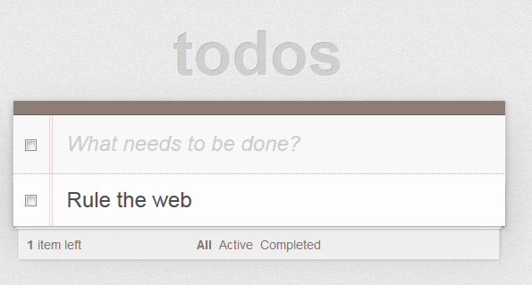
Let’s make this app with BDD of course.

Slide 4
Step 1. write specs
Stories
As a user I want to manage my todos so that I can achieve more in my life.
Scenarios
it should open the app
Given no app
when opening the app
then the title is shown
and the list is empty
it should add an item
Given an open app
when adding "Rule the web"
then "Rule the web" will shown in the list

Slide 5
Step 2. write tests
describe("As a user I want to manage my todos so that I can achieve more in my life.", function(){
beforeEach(function(done){
//when opening the app
open(done);
});
afterEach(function(){
//Given no app
close();
});
it("should open the app", function(){
//then the title is shown
expect($('h1').text()).toEqual('todos');
//and the list is empty
expect($('ul').html()).toEqual('');
});
it("should add an item", function(){
//when adding "Rule the web"
$('input').val("Rule the web");
$('form').submit();
//then "Rule the web" will shown in the list
expect($('ul li').text()).toEqual('Rule the web');
});
});

Slide 6
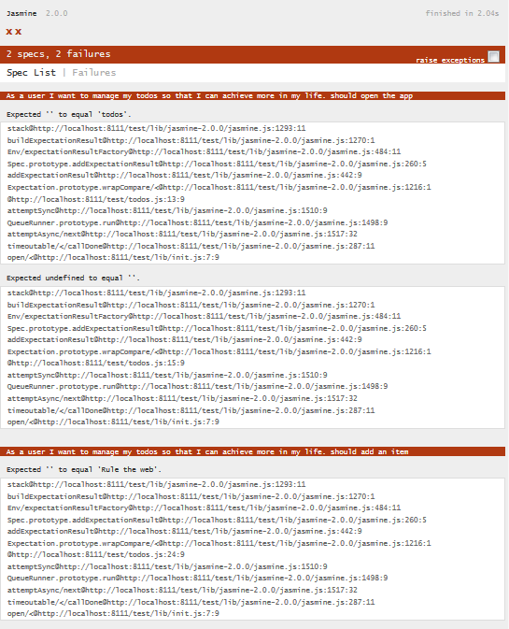
Step 3. make it red.

Slide 7
Step 4. write the app.
HTML
JS
<!DOCTYPE>
<HTML>
<head>
<link rel="stylesheet" type="text/css" href="css/base.css" />
<script src="lib/jquery-2.1.0.min.js"></script>
</head>
<body>
<h1>todos</h1>
<ul></ul>
<form>
<input/>
</form>
<script src='js/app.js'></script>
</body>
</HTML>
$(document).ready(function(){
$('form').submit(function(event){
event.preventDefault();
$('ul').append('<li><div class="view"><label>' + $('input').val() + '</label></div></li>');
});
});

Slide 8
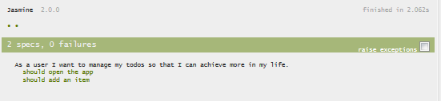
Step 5. make it green.

Slide 9

The result
No!! We can’t sent this to production.

Slide 10
No worries I will improve.
What are the issues?
Over complex test scripts.
No tests for styling.
Unreadable specs for the business.

Slide 11
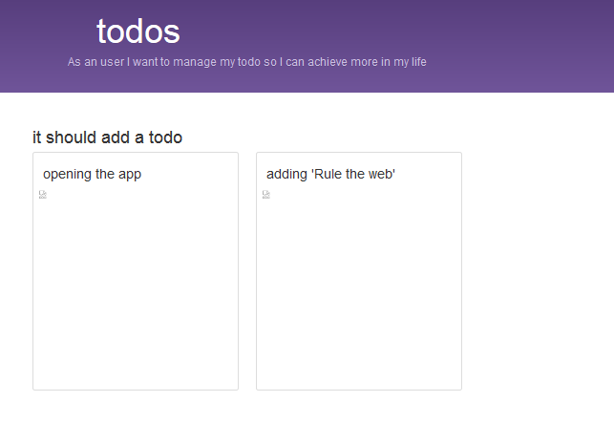
Step 1. reuse specs in storyboard

Slide 12
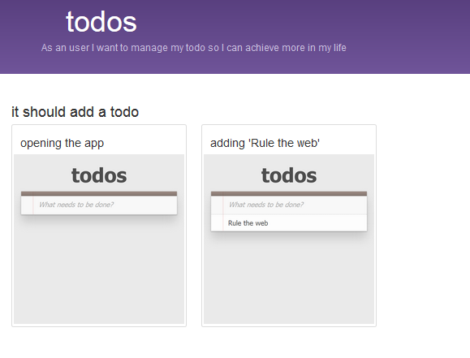
Step 2. create views

Slide 13
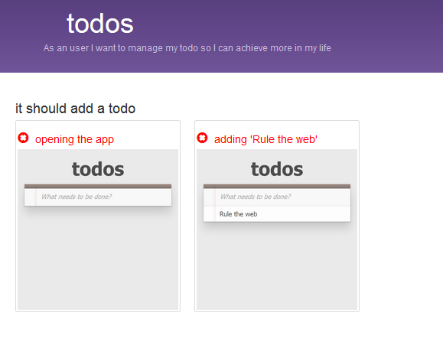
Step 3. make it red

Slide 14
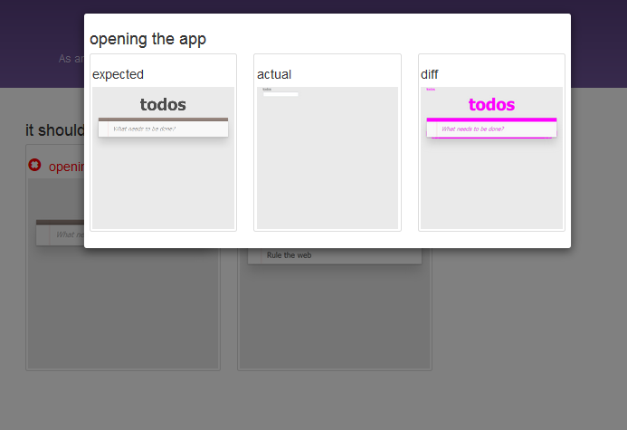
Step 3. what is wrong?

Slide 15
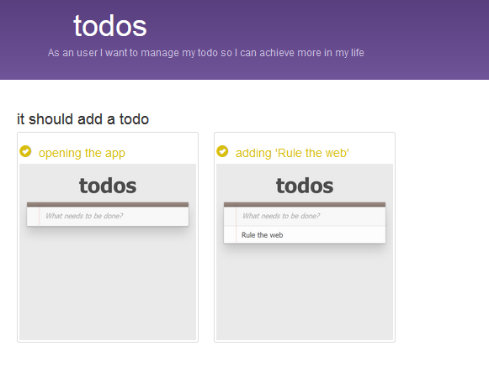
Step 4. make it green.

Slide 16
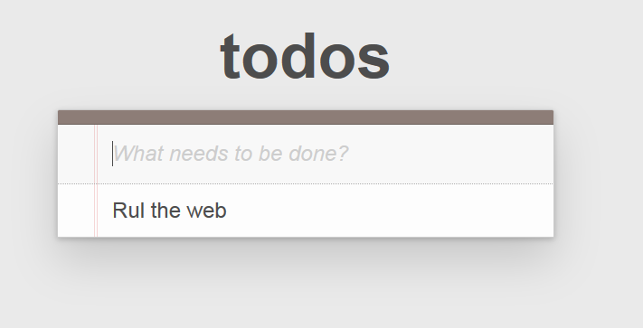
The result
Yes!! Let’s rule the web.

Slide 17
Yes it is on GITHUB
https://github.com/ov0364/xp2014_todos

Slide 18
Very Special Thanks
Jasmine
PhantomCSS
CasperJs
PhantomJs
Bootstrap
Mustache
JQuery
TodoMVC

